Slide 1
Quantum walk
4/3/2022
Vu Tuan Hai

Slide 2
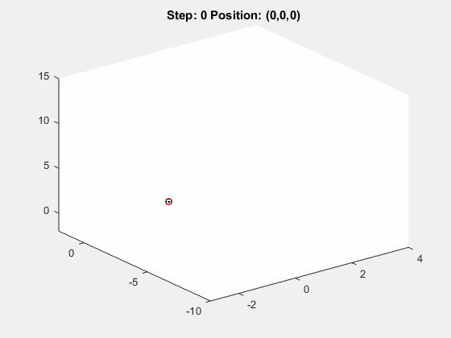
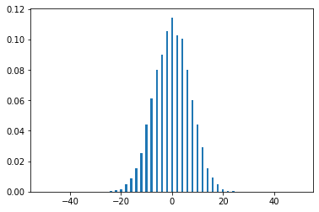

Random walk
Take the random variable $Z∈\{−1, 1\}$
The series ${\{S}_{n}\}$ is a 1-D random walk with $S_{0}=0$ and $S_{n}=\sum_{i=1}^{n}{Z_{i}}$

Slide 3


Random walk
Values of ${\{S}_{N}\}$
Normal distribution of $S_{N}$
More likely
Unlikely

Slide 4
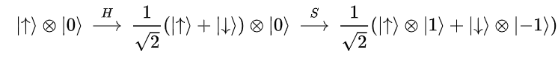
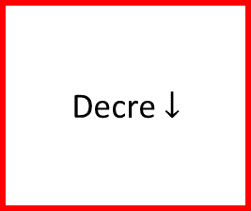
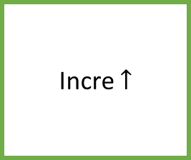
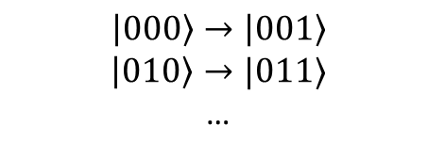
Quantum walk (using superposition)
Incre $↑$
Decre $↓$
$$\left|000\right\rangle →\left|001\right\rangle$$
$$\left|010\right\rangle →|011⟩$$
…
H

Slide 5
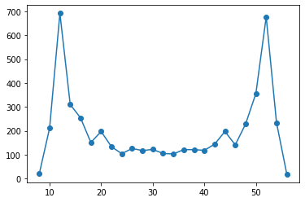


Quantum walk
Values of ${\{S}_{N}\}$
Paranormal distribution of $S_{N}$
Unlikely
More likely

Slide 6
Quantum walk
Quantum walk is described as product of 2 unitary operator: coin flip operator & shift operator

Slide 7

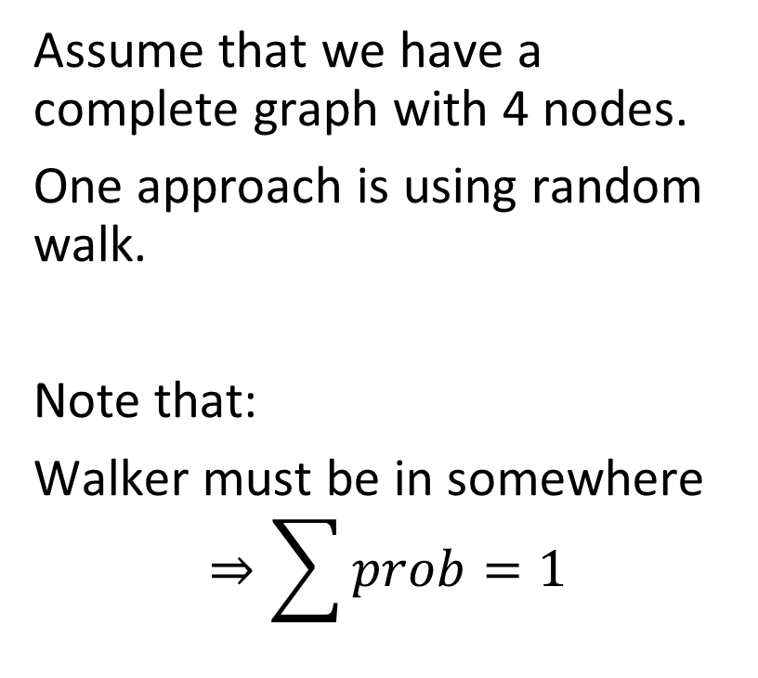
1. Spatial search (discrete time) – face with large graph
1
Assume that we have a complete graph with 4 nodes.
One approach is using random walk.
Note that:
Walker must be in somewhere
$$⇒\sum{prob=1}$$
4
2
3

Slide 8
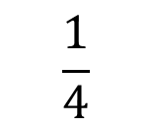
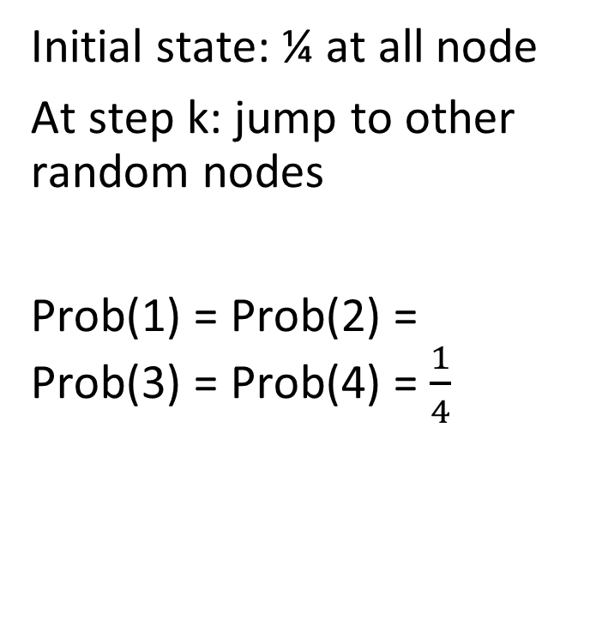
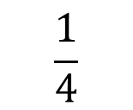
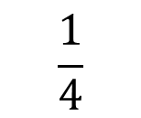
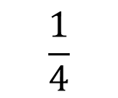
2. Random walk
$$\frac{1}{4}$$
1
Initial state: ¼ at all node
At step k: jump to other random nodes
Prob(1) = Prob(2) = Prob(3) = Prob(4) = $\frac{1}{4}$
Acts as absorb node
$$\frac{1}{4}$$
4
2
$$\frac{1}{4}$$
3
$$\frac{1}{4}$$

Slide 9
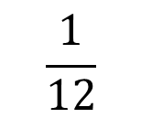
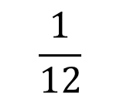
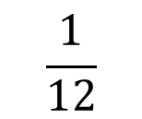
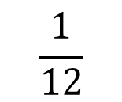
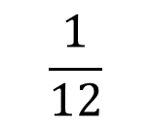
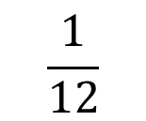
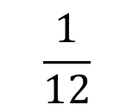
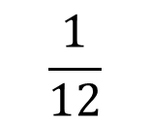
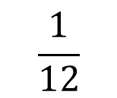
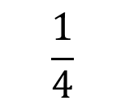
2. Random walk
$$\frac{1}{12}$$
$$\frac{1}{12}$$
1
At step 1:
$$\frac{1}{12}$$
$$\frac{1}{12}$$
$$\frac{1}{12}$$
4
2
$$\frac{1}{4}$$
$$\frac{1}{12}$$
$$\frac{1}{12}$$
3
$$\frac{1}{12}$$
$$\frac{1}{12}$$

Slide 10
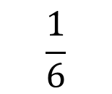
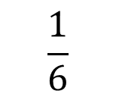
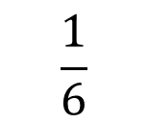
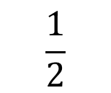
2. Random walk
$$\frac{1}{6}$$
1
When done step 1:
Prob(1) = Prob(3) = Prob(4) = 1/12*2 = 1/6
Prob(2) = 1/4+1/12*3 = 1/2
$$\frac{1}{6}$$
4
2
$$\frac{1}{2}$$
3
$$\frac{1}{6}$$

Slide 11
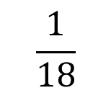
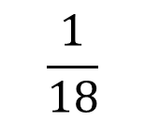
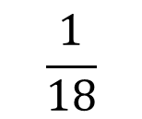
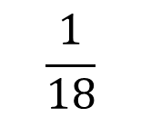
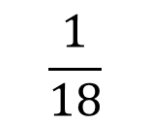
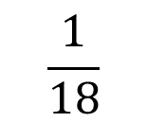
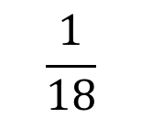
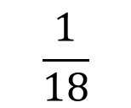
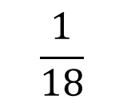
2. Random walk
$$\frac{1}{18}$$
$$\frac{1}{18}$$
1
At step 2:
$$\frac{1}{18}$$
$$\frac{1}{18}$$
$$\frac{1}{18}$$
4
2
$$\frac{1}{2}$$
$$\frac{1}{18}$$
$$\frac{1}{18}$$
3
$$\frac{1}{18}$$
$$\frac{1}{18}$$

Slide 12
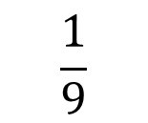
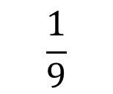
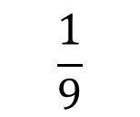
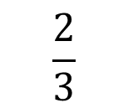
2. Random walk
$$\frac{1}{9}$$
1
When done step 2:
Prob(1) = Prob(3)= Prob(4) 1/18*2=1/9
Prob(2) = 1/2+1/18*3=2/3
$$\frac{1}{9}$$
4
2
$$\frac{2}{3}$$
3
$$\frac{1}{9}$$

Slide 13
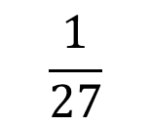
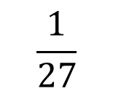
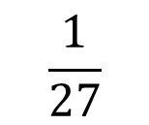
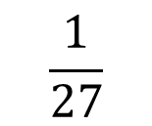
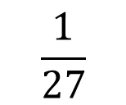




2. Random walk
$$\frac{1}{27}$$
$$\frac{1}{27}$$
1
At step 3:
$$\frac{1}{27}$$
$$\frac{1}{27}$$
$$\frac{1}{27}$$
4
2
$$\frac{2}{3}$$
$$\frac{1}{27}$$
$$\frac{1}{27}$$
3
$$\frac{1}{27}$$
$$\frac{1}{27}$$

Slide 14




2. Random walk
$$\frac{2}{27}$$
1
When done step 3:
Prob(1) = Prob(3)= Prob(4) 1/27*2=2/27
Prob(2) = 2/3+1/27*3=7/9
$$\frac{2}{27}$$
4
2
$$\frac{7}{9}$$
3
$$\frac{2}{27}$$

Slide 15


2. Random walk
Prob(Success) at time t = $1−\frac{N−1}{N}{\left(\frac{N−2}{N−1}\right)}^{t}$
Runtime: $O(N)$

Slide 16













3. Quantum walk
$$α_{14}$$
1
$$α_{12}$$
Change 4 probs to 12 amplitudes of a wave function $\left|ψ\right\rangle ≔\{α_{i}\}$
Init: $|ψ(0)⟩$
Note that at intermediate steps we cannot observe the system. Then we do not know the current node is the marked node or not.
$$α_{41}$$
$$α_{21}$$
$$α_{13}$$
4
2
$$α_{42}$$
$$α_{24}$$
$$α_{31}$$
$$α_{43}$$
$$α_{23}$$
3
$$α_{34}$$
$$α_{32}$$

Slide 17














3. Quantum walk
At node 2: A = $\frac{−1}{\sqrt{12}}∗\frac{3}{3}$
$$\frac{1}{\sqrt{12}}$$
$$\frac{1}{\sqrt{12}}$$
1
At step 1
1a. Query oracle:
$$Q|ψ\left(0\right)⟩$$
1b. Apply a quantum coin flip (-I+2A) that inverts each amplitude about the average amplitude at its vertex. (Nothing happen)
$$C(Q|ψ\left(0\right)⟩)$$
$$\frac{1}{\sqrt{12}}$$
$$−\frac{1}{\sqrt{12}}$$
$$\frac{1}{\sqrt{12}}$$
$$\frac{1}{\sqrt{12}}$$
$$−\frac{1}{\sqrt{12}}$$
2
4
$$\frac{1}{\sqrt{12}}$$
$$\frac{1}{\sqrt{12}}$$
$$−\frac{1}{\sqrt{12}}$$
3
$$\frac{1}{\sqrt{12}}$$
$$\frac{1}{\sqrt{12}}$$

Slide 18







3. Quantum walk
$$\frac{1}{\sqrt{12}}$$
$$−\frac{1}{\sqrt{12}}$$
1
1c. Shift operator (walk): walker at vertex i pointing to vertex j to hop to vertex j and point back to vertex i $⇒$ Swap $α_{ij}$ with $α_{ji}$.
$$SCQ\left|ψ\left(0\right)\right\rangle =|ψ\left(1\right)⟩$$
$$\frac{1}{\sqrt{12}}$$
$$\frac{1}{\sqrt{12}}$$
$$−\frac{1}{\sqrt{12}}$$
$$\frac{1}{\sqrt{12}}$$
$$\frac{1}{\sqrt{12}}$$
2
4
$$\frac{1}{\sqrt{12}}$$
$$\frac{1}{\sqrt{12}}$$
$$\frac{1}{\sqrt{12}}$$
3
$$\frac{1}{\sqrt{12}}$$
$$−\frac{1}{\sqrt{12}}$$

Slide 19

3. Quantum walk
$$\frac{1}{\sqrt{12}}$$
$$−\frac{1}{\sqrt{12}}$$
1
At step 2
2a. Query oracle:
$$Q|ψ\left(1\right)⟩$$
$$\frac{1}{\sqrt{12}}$$
$$−\frac{1}{\sqrt{12}}$$
$$−\frac{1}{\sqrt{12}}$$
$$\frac{1}{\sqrt{12}}$$
$$−\frac{1}{\sqrt{12}}$$
2
4
$$\frac{1}{\sqrt{12}}$$
$$\frac{1}{\sqrt{12}}$$
$$−\frac{1}{\sqrt{12}}$$
3
$$\frac{1}{\sqrt{12}}$$
$$−\frac{1}{\sqrt{12}}$$

Slide 20


3. Quantum walk
Reflected amp
2b. The coin inverts or reflects each amplitude about their average.
(-I+2A)
At node 1: $A=\frac{\frac{1}{\sqrt{12}}+\frac{1}{\sqrt{12}}−\frac{1}{\sqrt{12}}}{3}=\frac{1}{6\sqrt{3}}$
$$⇒α_{12}=−α_{12}+2A=\frac{5}{6\sqrt{3}}$$
$$⇒α_{13}=−α_{13}+2A=\frac{−1}{6\sqrt{3}}$$
Current amp

Slide 21













3. Quantum walk
$$\frac{−1}{6\sqrt{3}}$$
$$\frac{5}{6\sqrt{3}}$$
1
2c. Shift operator (walk): swap $α_{ij}$ with $α_{ji}$.
$$\frac{−1}{6\sqrt{3}}$$
$$−\frac{1}{2\sqrt{3}}$$
$$\frac{−1}{6\sqrt{3}}$$
$$−\frac{1}{2\sqrt{3}}$$
4
2
$$\frac{5}{6\sqrt{3}}$$
$$\frac{−1}{6\sqrt{3}}$$
$$\frac{−1}{6\sqrt{3}}$$
$$−\frac{1}{2\sqrt{3}}$$
3
$$\frac{−1}{6\sqrt{3}}$$
$$\frac{5}{6\sqrt{3}}$$

Slide 22











3. Quantum walk
$$\frac{11}{108}$$
$$\frac{−1}{6\sqrt{3}}$$
$$−\frac{1}{2\sqrt{3}}$$
1
2c. Shift operator (walk): swap $α_{ij}$ with $α_{ji}$.
$$\frac{−1}{6\sqrt{3}}$$
$$\frac{5}{6\sqrt{3}}$$
$$−\frac{1}{2\sqrt{3}}$$
$$\frac{−1}{6\sqrt{3}}$$
$$\frac{5}{6\sqrt{3}}$$
2
$$\frac{11}{108}$$
4
$$\frac{25}{36}$$
$$\frac{−1}{6\sqrt{3}}$$
$$\frac{−1}{6\sqrt{3}}$$
$$\frac{5}{6\sqrt{3}}$$
3
$$\frac{−1}{6\sqrt{3}}$$
$$−\frac{1}{2\sqrt{3}}$$
$$\frac{11}{108}$$

Slide 23




3. Quantum walk
Prob(Success) at time t =
Runtime: $O(\sqrt{N})$
N=4
N=100

Slide 24


References
Thomas Wong,
Creighton University

Slide 25

















Update $θ$
Optimizer$(θ^{t},∇ℒ)$
$$U$$
$$V\left(θ\right)$$
a)
$${\left|0\right\rangle }^{⊗n}$$
$$∇ℒ$$
Quantum part
Classical part
$$θ_{0}$$
$$θ_{3}$$
$$θ_{6}$$
b)
$$θ_{1}$$
$$θ_{4}$$
$$θ_{7}$$
$$θ_{2}$$
$$θ_{5}$$
$$θ_{8}$$
$$×L$$

Slide 26







$$θ_{0}$$
$$θ_{3}$$
$$θ_{6}$$
$$θ_{1}$$
$$θ_{4}$$
$$θ_{7}$$
$$θ_{2}$$
$$θ_{5}$$
$$θ_{8}$$
$$×L$$

